Slide 1
Credit card fraud detection
Capstone project
By shalini

Slide 2


Slide 3
Brief overview about the business problem
In simple terms it is nothing but we need to detect a fraud credit card transaction.
So we have a lot of banks who does not want to go into losses based on a fraud transaction.
If there is a fraud transaction then the bank needs to pay the amount to the user customer who have lost the money from his\her card.

Slide 4
Business requirement
We need a machine learning model which can identify a fraud transaction and save the bank from repaying the amount
Which can help the bank grow financially and also, this could help to attract a lot of customer who would feel safe on having a credit from corresponding bank

Slide 5
Data set
-- ------ -----
0 trans_date_trans_time object
1 cc_num int64
2 merchant object
3 category object
4 amt float64
5 first object
6 last object
7 gender object
8 street object
9 city object
10 state object
11 zip int64
12 lat float64
13 long float64
14 city_pop int64
15 job object
16 dob object
17 trans_num object
18 unix_time int64
19 merch_lat float64
20 merch_long float64
21 is_fraud int64 dtypes: float64(5), int64(5), object(12) memory usage: 325.1+ MB
1). Data set mainly consist of categorical columns rather then numerical columns
2). The data used here is the concatenation of the train and test data set provided from kaagle.

Slide 6
Data set quality check
trans_date_trans_time 0.0 cc_num 0.0
merchant 0.0
category 0.0
amt 0.0
first 0.0
last 0.0
gender 0.0
street 0.0
city 0.0
state 0.0
zip 0.0
lat 0.0
long 0.0
city_pop 0.0
job 0.0
dob 0.0
trans_num 0.0
unix_time 0.0
merch_lat 0.0
merch_long 0.0
is_fraud 0.0
dtype: float64
1). Data set looks good without any null or duplicate columns
2). But we have few columns which we are not required and we can remove them during building our model.

Slide 7
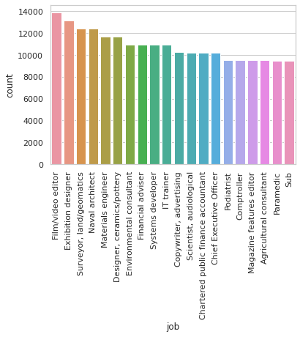
EDA
We try to observe different pattern and combination in the data set using graphs this helps us in understanding the insight of data

Slide 8
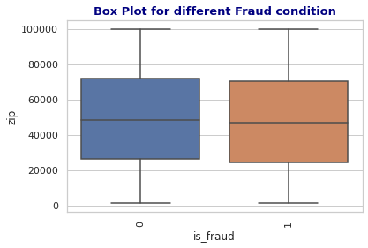
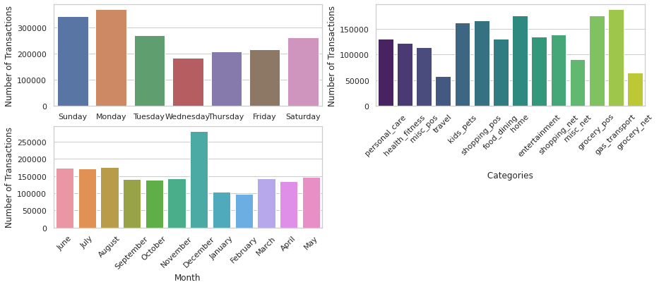
Analysis
Bar graphs Analysis
Box plot Analysis

Slide 9
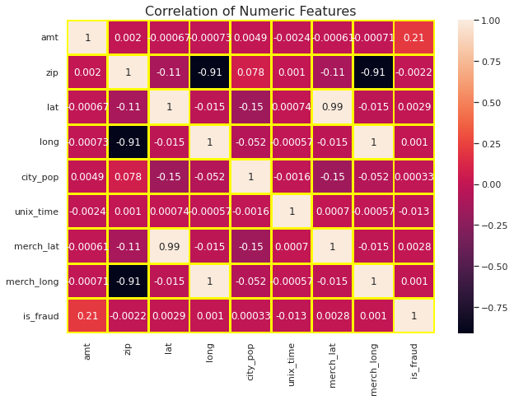
Correlation heat map

Slide 10
Requirements for model building
Here I was trying to build a logistic regression model so for that I was trying to use the categorical values to convert into numerical formal
Creating dummy variables for better representation
And also , bring few new field which would help model in better training

Slide 11
Following are the steps followed for creating dummy variables
Converting the data field
Converting the data field for using it to pick new field
Spliting and converting data to days to weeks
Dividing the data field to pick values like
month ,year, date etc
We used data field to get the days of the week

Slide 12
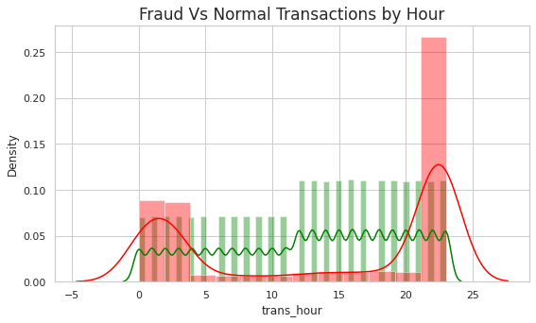
Observation with no. of transaction per hour

Slide 13
Few observations
Highest number of transaction are in month of December
Lowest number of transaction happens in February
Female customers are using credit card for their transaction .

Slide 14
Percentile distribution
index | Category | category_count | percent
0 | 2 | gas_transport | 188029 | 10.150594
1 | 4 | grocery_pos | 176191 | 9.511529
2 | 6 | home | 175460 | 9.472067
3 | 12 | shopping_pos | 166463 | 8.986371
4 | 7 | kids_pets | 161727 | 8.730702
index | Category | category_count | percent
0 | 2 | gas_transport | 188029 | 10.150594
1 | 4 | grocery_pos | 176191 | 9.511529
2 | 6 | home | 175460 | 9.472067
3 | 12 | shopping_pos | 166463 | 8.986371
4 | 7 | kids_pets | 161727 | 8.730702

Slide 15
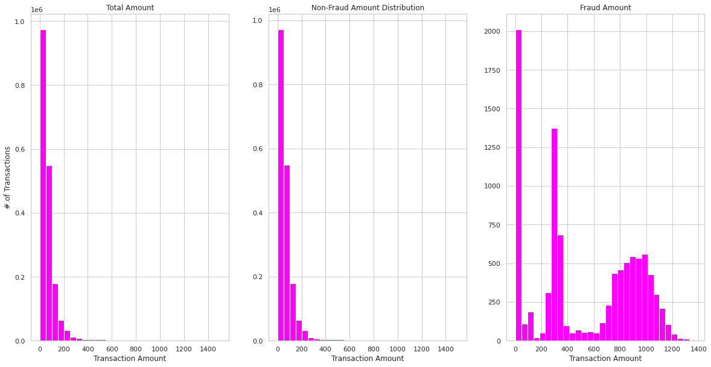

Slide 16
Model training
1).logreg = LogisticRegression(random_state=42)
logreg.fit(X_train, y_train)
y_train_pred = logreg.predict(X_train)
y_test_pred = logreg.predict(X_test)
2).dt_clf = DecisionTreeClassifier(criterion ='gini’, max_depth = 20, random_state=0)
dt_clf.fit(X_train, y_train)
3).from sklearn.ensemble import RandomForestClassifier
rf_clf = RandomForestClassifier(random_state=345)
param_grid = {
'n_estimators': [50],
'max_depth' : [8,16,20]
}
Model building using logistic regression , Decision trees, Random forest

Slide 17
Confusion matrix using logisticregression
precision recall f1-score support
0 0.79 0.92 0.85 1289742
1 0.91 0.75 0.82 1290098
accuracy 0.84 2579840
macro avg 0.85 0.84 0.84 2579840
weighted avg 0.85 0.84 0.84 2579840
1192673 | 97069
322880 | 967218

Slide 18
Confusion matrix using Decisiontree
1282628 | 7114
0 | 1290098
precision recall f1-score support
0 1.00 0.99 1.00 553001
1 0.99 1.00 1.00 552645
accuracy 1.00 1105646
macro avg 1.00 1.00 1.00 1105646
weighted avg 1.00 1.00 1.00 1105646

Slide 19
Confusion matrix using Randomforest
precision recall f1-score support
0 1.00 1.00 1.00 1289742
1 1.00 1.00 1.00 1290098
accuracy 1.00 2579840
macro avg 1.00 1.00 1.00 2579840
weighted avg 1.00 1.00 1.00 2579840
1287366 | 2376
0 | 1290098

Slide 20
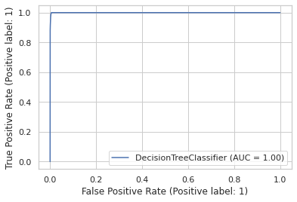
The roc curve

Slide 21
Thank you

